Slide 1

Identifying High-Demand Crops For Data Visualization
Batch 15
Aditya Ganti
Ponnuri Pavan Kumar
M Praneeth Sai
Kotla Vivek
Siva Ganesh Under The Guidance Of
Dr. T.M.N Vamsi
Dept of CSE, GST

Slide 2
Problem Statement: Identifying High-Demand Crops for Data Visualization
India, despite its vast agricultural landscape, lags in the production of several high-demand crops that dominate global markets. Many of these crops, such as avocados, blueberries, and quinoa, are produced in minimal quantities, limiting the country's potential to meet domestic and international demand. This gap presents missed opportunities for farmers, investors, and policymakers who could benefit from strategic agricultural expansion.
This project seeks to identify over 25 such high-demand crops where India significantly trails leading global producers. By gathering and analysing data on production volumes, regional cultivation feasibility, and market trends, we aim to develop insightful data visualisations. These visualisations will highlight potential areas for farm development and investment, guiding stakeholders toward informed agricultural decision-making.
Dept of CSE, GST

Slide 3
Outcomes Of This Project
High-Demand Crop List – Identifying 25+ crops where India lags in global production.
Structured Dataset – Key data on global producers, India's production, climatic needs, and market trends.
Data Visualizations – Graphs/maps highlighting production gaps, cultivation feasibility, and investment potential.
Strategic Recommendations – Insights on suitable Indian regions for cultivation and policy suggestions.
Key Findings Report – Summarized insights for farmers, investors, and policymakers.
Agricultural Awareness – Helping farmers align with global market trends.
Dept of CSE, GST

Slide 4
Plan of Action (Utilised So Far)
Item
Objective Setting
Literature Review
Approach
Data Sources
Technologies To Be Used
Expected Output
Dept of CSE, GST

Slide 5
Literature Review
We have gone through more than 30 research papers pertaining to visualisations in the Agriculture industry. We have not found any Research Papers that compare India’s production standards with global ones and don’t identify the crops either. They mainly focus on improving crop yield in India using smart cropping and other techniques.
The titles of the papers are as follows:
Intelligent Smart Farming and Crop Visualisation
Agricultural Data Visualisation for Prescriptive Crop Planning
Agriculture Data Visualisation and analysis using data mining techniques: Application of Unsupervised Machine Learning
Data Visualisation and Analytics for Crop Management: A Big Data View
Dept of CSE, GST

Slide 6
Literature Review Outcomes
1. Data Visualization for Better Insights:
Interactive and graphical representations of data improve comprehension, trend analysis, and decision-making.
Enables policymakers, investors, and farmers to identify patterns, correlations, and key insights from agricultural data.
Helps highlight production gaps, investment opportunities, and regional feasibility for cultivating high-demand crops.
2. Big Data Analytics for Optimized Agriculture:
Utilizes historical data, real-time inputs, and large datasets to enhance agricultural planning.
Enables precision farming, predictive modelling, and resource optimisation to improve crop yield management.
Assists in identifying market trends, demand forecasting, and potential risk factors, supporting better decision-making in the agricultural sector.
3. Climate Change Consideration in Crop Production:
Analyzes the impact of climate change on soil fertility, water availability, and temperature fluctuations affecting crop yields.
Helps in developing adaptive strategies for farmers, such as recommending climate-resilient crops and sustainable farming practices.
Supports policy recommendations for mitigating risks associated with erratic weather patterns, ensuring food security and long-term agricultural sustainability.
Dept of CSE, GST

Slide 7
Approach Of This Project
Identify The Dataset Containing All The Data Of Countries And Their Crops Produced.
Identifying Crops
Identify The Crops In Which India Is Lagging Compared To Global Counterparts And Potential Reason.
Data Source
Identifying Countries
Identify Countries That Have A Similar Standard To India In Terms Of Agricultural Production
Visualising Data
Visualise The Data Using Visualisation Tools For Summarization And Better Decision Making.
Comparison of Data
Compare India’s Performance With Other Counterparts In Terms Of Production.
Dept of CSE, GST

Slide 8
Primary Data Sources
1. Kaggle Datasets:
We have identified the "Crop Statistics FAO - All Countries" dataset, which provides comprehensive data on crop production across all countries from 1961 to 2019.
This publicly available dataset includes detailed production statistics, trends, and comparisons that will help analyse India’s agricultural performance relative to global leaders.
2. UN Crops FAOSTAT - https://www.fao.org/faostat/en/#data/QCL
We have sourced the data from the official UN Food and Agriculture Organisation(FAO) statistics dataset, which provided comprehensive data for all countries across all crops from the years 1961 to 2023.
Dept of CSE, GST

Slide 9
Technologies Used
1. Python:
Used for data pre-processing, including cleaning, transformation, and handling missing values.
May also be used for data visualisation if needed, leveraging libraries like Matplotlib and Seaborn for trend analysis and comparisons.
2. SQL:
Used for data analysis and querying, allowing efficient filtering, grouping, and comparison of crop production data across countries.
Helps in extracting insights by grouping countries, analysing production trends, and comparing India's performance with global leaders.
3. Power BI:
The primary tool for data visualisation, enabling the creation of interactive dashboards, charts, and reports.
Will help in effectively presenting insights, identifying patterns, and showcasing production gaps in India compared to leading global producers.
Dept of CSE, GST

Slide 10
Expected Output: An Interactive Dashboard
We will create a comprehensive Power BI dashboard to present key findings, trends, and insights.
Key Features:
Crop Production Trends: Visual analysis of growth patterns and comparisons between India and global producers.
Global & Regional Insights: Interactive maps and charts highlighting production levels and potential growth areas in India.
Customizable Filters: Users can adjust views by crop, country, or time period for tailored insights.
Data-Driven Decisions: Supports farmers, policymakers, and investors in making informed choices for agricultural development.
This dashboard will serve as an intuitive and insightful tool for exploring and interpreting global agricultural data.
Dept of CSE, GST

Slide 11
Requirements Gathering
Functional Requirements
Identify High-Demand Crops:
Select 25+ globally high-demand crops with low production in India.
Compare India’s production with leading global producers to identify gaps.
Data Collection & Integration:
Source data from Kaggle, OurWorldInData.org, FAO, and other databases.
Extract key metrics like production volumes, regions, and climatic needs.
Data Processing & Analysis:
Use Python for data cleaning and preprocessing.
Analyze trends using SQL for filtering, grouping, and comparisons.
Visualization & Dashboard:
Build an interactive Power BI dashboard with charts, maps, and filters.
Provide customisable views for crops, time periods, and country trends.
Actionable Insights for Stakeholders:
Offer data-driven recommendations for farmers, investors, and policymakers.
Identify high-potential crops and regions for strategic investment.
This project will leverage data analytics to enhance India’s agricultural competitiveness through informed decision-making.
Dept of CSE, GST

Slide 12
Requirements Gathering
Non-Functional Requirements
Performance:
Ensure efficient data handling for smooth processing and quick visualization rendering.
Optimize queries and minimise load times for a seamless user experience.
Scalability:
The system should support new datasets and additional crops without performance degradation.
Allow future expansion to incorporate more agricultural trends and insights.
Usability:
Design a user-friendly, intuitive dashboard with easy navigation and customisable filters.
Ensure accessibility for policymakers, investors, and farmers with minimal technical expertise.
This project aims to provide a high-performing, scalable, and user-centric visualisation system for better agricultural insights.
Dept of CSE, GST

Slide 13
System Design: Implemented Using UML Diagrams.
UML(Unified Model Language): This is a standardised visual language for designing and documenting software systems through diagrams that represent structure and behaviour, serving as a blueprint for development.
Class Diagram: This diagram represents the structure of the system, including classes, attributes, and relationships.
Usecase Diagram: This diagram shows the interactions between users (actors) and the system.
Sequence Diagram: This diagram shows the flow of interactions between objects over time.
Activity Diagram: This diagram shows the workflow of the project, including decision points and parallel activities.
Component Diagram: This diagram shows the physical or logical components of the system.
Dept of CSE, GST

Slide 14
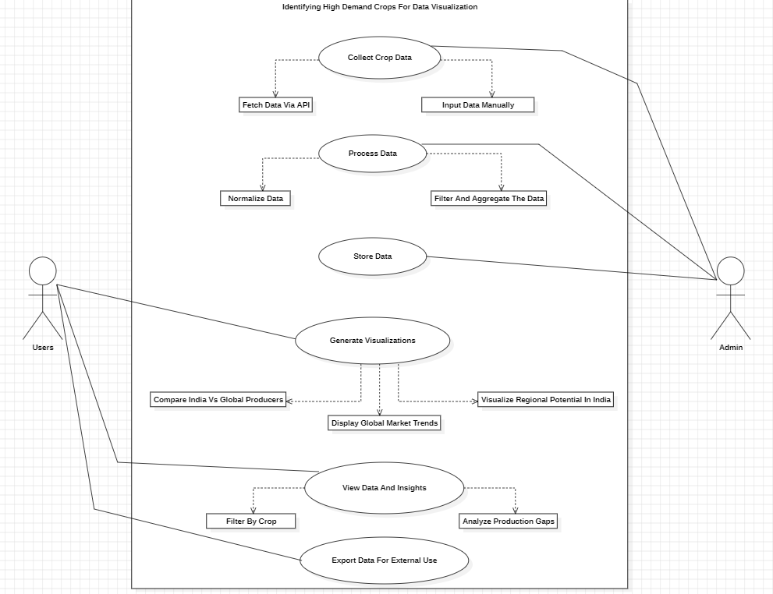
System Design: Finalized UML Diagrams
Usecase Diagram:
Dept of CSE, GST

Slide 15
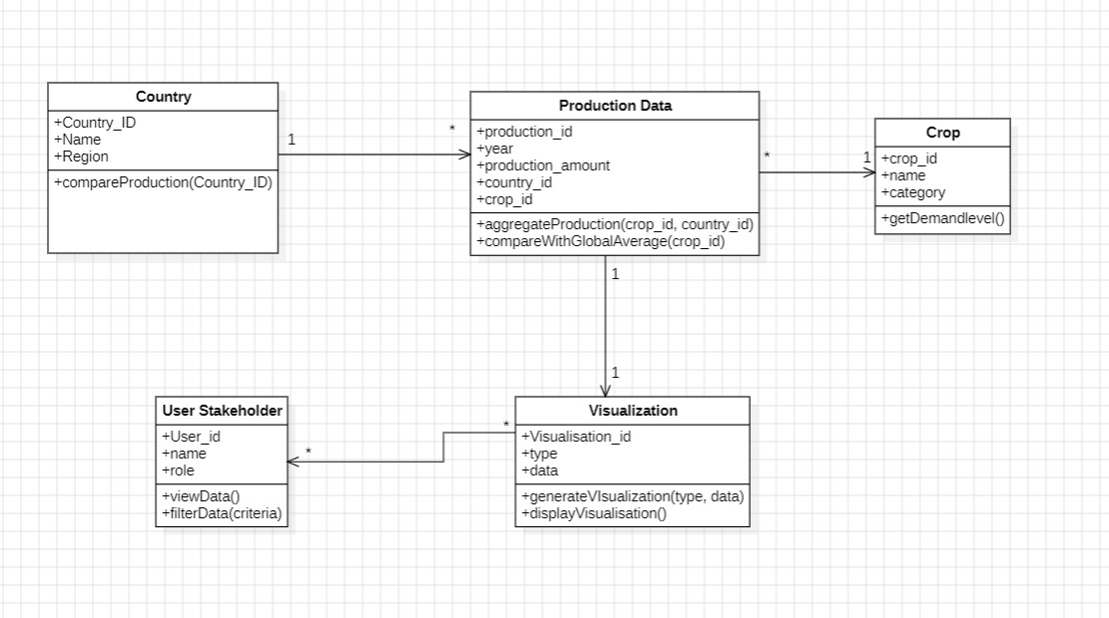
System Design: Finalized UML Diagrams
Class Diagram:
Dept of CSE, GST

Slide 16
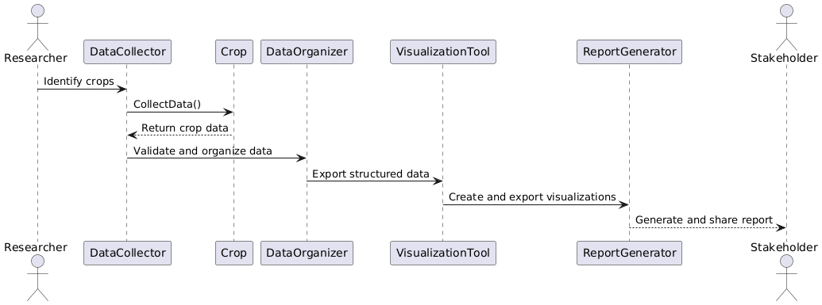
System Design: Finalized UML Diagrams
Sequence Diagram:
Dept of CSE, GST

Slide 17
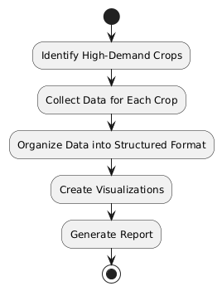
System Design: Finalized UML Diagrams
Activity Diagram:
Dept of CSE, GST

Slide 18
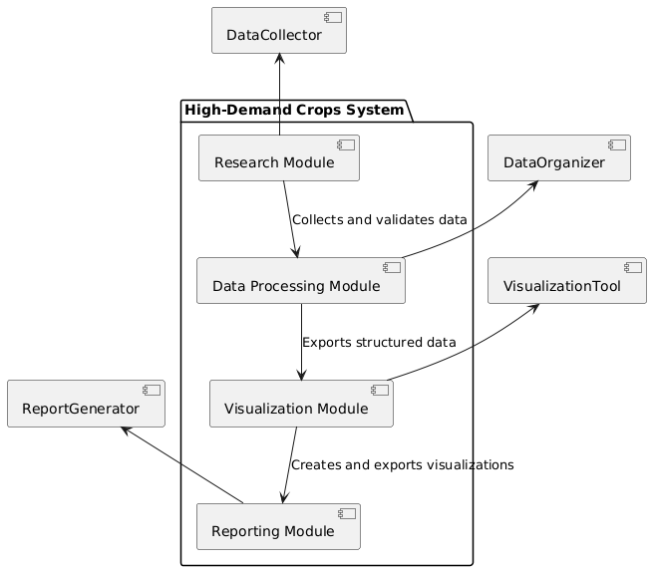
System Design: Finalized UML Diagrams
Component Diagram:
Dept of CSE, GST

Slide 19
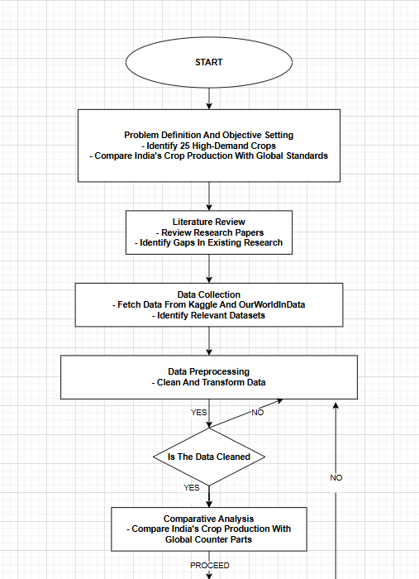
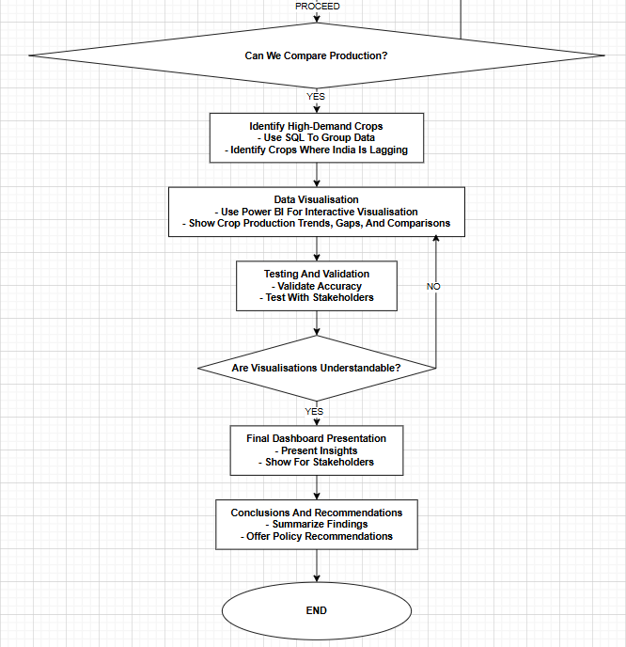
System Design: Proposed Methodology
Dept of CSE, GST

Slide 20
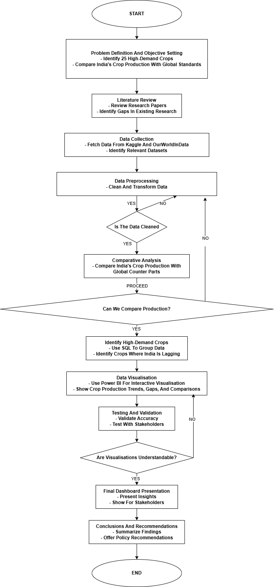
System Design: Proposed Methodology
Dept of CSE, GST

Slide 21
Front-End Design:- The front-end is the user-facing part of the system. It includes the user interface (UI) and user interaction.
User Design Web Interface
User Opens The Dashboard In The Browser.
User Selects Filters (Crop, Region, Year)
User Choose Data Parameters For Visualisation.
Users Can Export Insights For Offline Use.
Front-End Sends API Requests To Back-End
User Downloads Report (PDF/CSV)
The Selected Filters Are Sent To The Django REST API.
Users Zoom In, Hover Over Graphs, And Explore Trends.
Back-End Fetches Data From Database
User Interacts With Visualisations
Database Query Retrieves Relevant Crop Production Data.
Power BI Loads The Updated Visualisation.
Back-End Generates Power BI Embed Token
Power BI Loads The Updated Visualisation.
Front-End Updates Power BI Dashboard
Dept of CSE, GST

Slide 22
Back-End Design:- The back-end handles data processing, analysis, and visualisation.
Data Collection From Data Sources
Fetching Datasets Containing Global And India Crop Production.
Dashboard Refreshes With New Insights.
Preprocessing Data (Cleaning, Normalization Etc.)
Power BI Updates Dashboard
Handle Missing Values, Normalize Formats For Consistency.
Embed URL Is Sent For Dynamic Visualisation.
Storing Data In PostgreSQL/MySQL
Send Data & Embed URL To Front-End
Structured Data Is Stored Using Django ORM.
API Call To Power BI Returns An Authentication Token.
User Sends Request Via Front-End
Generate Secure Power BI Embed Token
Filters Selected By Users Trigger An API Request.
SQL Queries Retrieve Filtered Crop Data.
Back-End Receives API Request
Django REST API Processes The Request.
Fetch Filtered Data From Database
Dept of CSE, GST

Slide 23
Usability Design:- The usability design ensures the system is user-friendly and meets user needs.
Authentication Ensures Secure Access To Reports.
User Login Into System
Users Land On The Homepage With Key Visualisation.
Navigation To Dashboard
Filters Adjust Data Display For Custom Insights.
User Selects Filters (Crop, Year, Region Etc.)
Yes
Data Available
No
A Clear Message Guides Users On Missing Data.
Display Power BI Insights
Dynamic Graphs And Table Update With Selected Data.
Show Error Message (“No Data Available)
The System Recommends Different Parameter Selections.
Allow User Interactions (Zoom, Hover, Etc.)
Users Explore Trends With Interactive Elements.
Suggest Alternatives Filters
User Needs
Users Can Export Insights In Multiple Formats.
Allow Report Download (PDF/CSV)
Feedback Is Collected For System Improvements.
User Provides Feedback (Optional)
Dept of CSE, GST

Slide 24
Implementation
Python Program To Check Whether The Dataset Contains All The Required Countries Are Not. Especially India.
Pseudocode: Filtering Specific Countries from Dataset
1. Import Required Library
Import `pandas` as `pd`.
2. Load Dataset
Define `file_path` as the location of `Aggregated_Crop_Data.csv`.
Read the CSV file into a DataFrame (`data`).
3. Define Countries to Keep
Create a list `countries_to_include` with selected country names:
`China, United States of America, Brazil, India, Russia, France, Mexico, Japan, Germany, Turkey`.
4. Filter Data
Select only rows where the `Country` column matches values in `countries_to_include`.
5. Save Filtered Data
- Define `output_file` as the location for `Filtered_Crop_Data.csv`.
- Save the filtered data to a new CSV file without the index.
6. Print Confirmation Message
- Display a message confirming that the filtered data is saved.
Dept of CSE, GST

Slide 25
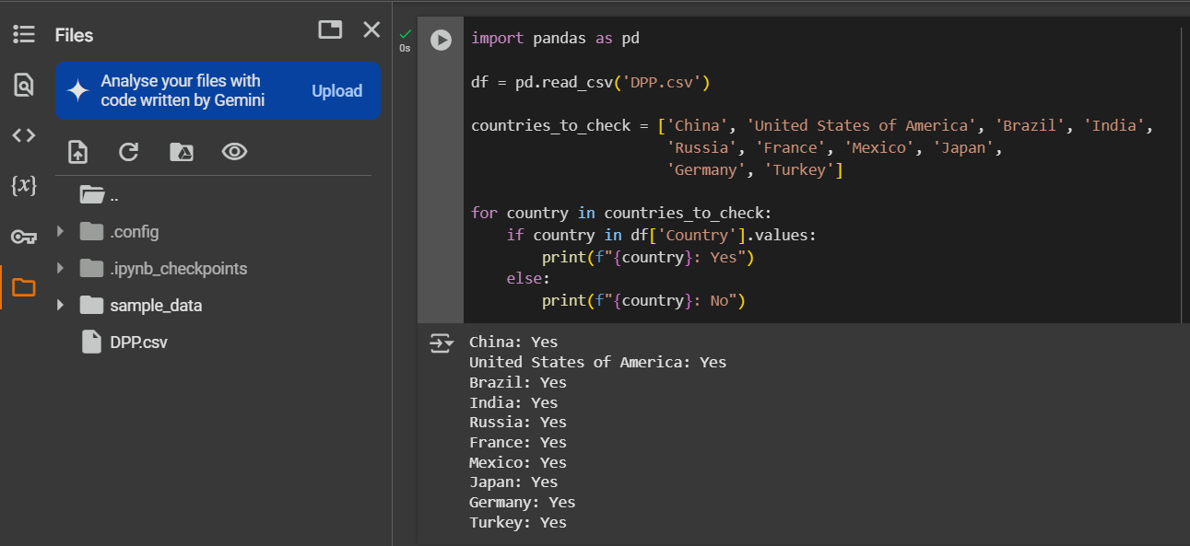
Sample Data Processing: Code Snippets
1. Checking Whether The Required Countries Present Or Not.
Dept of CSE, GST

Slide 26
Implementation
Python Program To Aggregate The Dataset From The Year 2016 To 2023, Check The Total Production, Total Area Harvested, and Total Yield from The Aggregated Dataset.
1. Import Required Library
- Import the Pandas library to handle data operations.
2. Define File Path and Load Data
- Set the file path for the dataset (`DPP.csv`).
- Read the CSV file into a Pandas DataFrame.
3. Filter Data for Years 2016 to 2023
- Apply a condition to retain only the rows where the **"Year"** column is between **2016 and 2023**.
4. Print Column Names
- Display the column names to verify data structure.
5. Aggregate Data by 'Country' and 'Crop
- Group data by 'Country' and 'Crop'.
- Compute the sum of:
- Production (t)
- Area Harvested (ha)
- Yield (kg/ha)
6. Rename Columns for Better Readability
- Change column names to:
- 'Production (t)' → 'Total Production (t)'
- 'Area Harvested (ha)' → 'Total Area Harvested (ha)'
- 'Yield (kg/ha)' → 'Total Yield (kg/ha)'
7. Save the Aggregated Data to a New CSV File
- Define an output filename (`Aggregated_Crop_Data.csv`).
- Save the modified dataset to this file.
8. Print Success Message
- Display a confirmation message that data aggregation and saving were successful.
Dept of CSE, GST

Slide 27
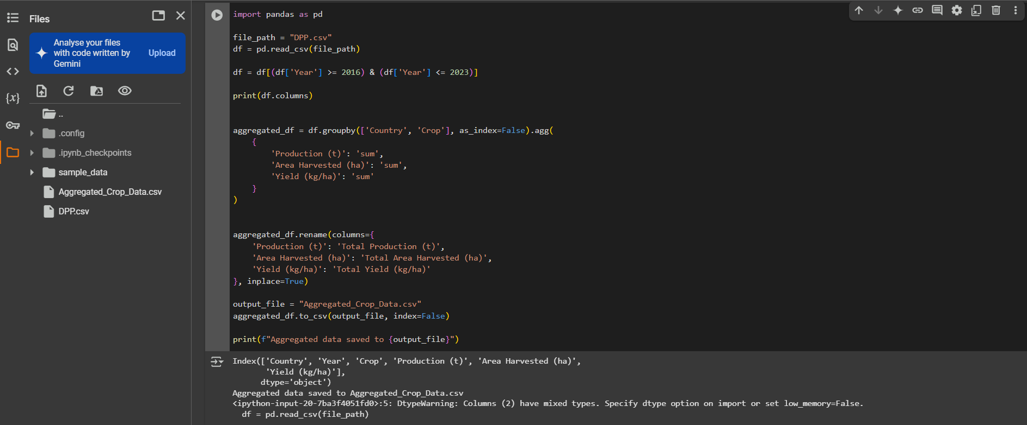
Sample Data Processing: Code Snippets
2. Python Program To Aggregate The Dataset From The Year 2016 To 2023, Check The Total Production, Total Area Harvested, and Total Yield from The Aggregated Dataset.
Dept of CSE, GST

Slide 28
Implementation
Python Program For Filtering The Required Countries.
Pseudocode: Filtering Specific Countries from Dataset
1. Import Required Library
- Import `pandas` as `pd`.
2. Load Dataset
- Define `file_path` as the location of `Aggregated_Crop_Data.csv`.
- Read the CSV file into a DataFrame (`data`).
3. Define Countries to Keep
- Create a list `countries_to_include` with selected country names:
- `China, United States of America, Brazil, India, Russia, France, Mexico, Japan, Germany, Turkey`.
4. Filter Data
- Select only rows where the `Country` column matches values in `countries_to_include`.
5. Save Filtered Data
- Define `output_file` as the location for `Filtered_Crop_Data.csv`.
- Save the filtered data to a new CSV file without the index.
6. Print Confirmation Message
- Display a message confirming that the filtered data is saved.
Dept of CSE, GST

Slide 29
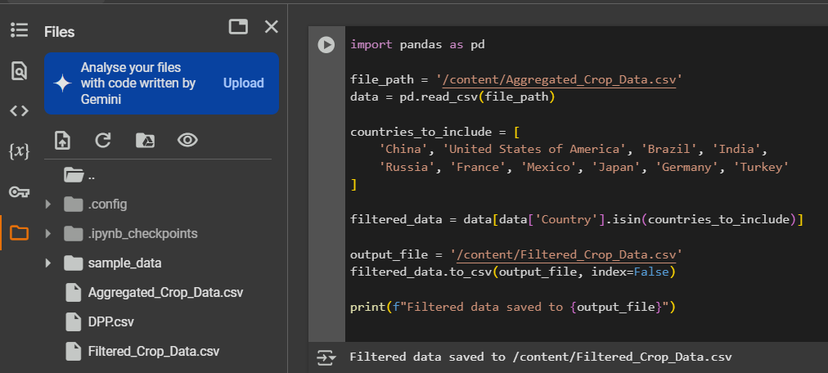
Sample Data Processing: Code Snippets
3. Python Program For Filtering The Required Countries.
Dept of CSE, GST

Slide 30
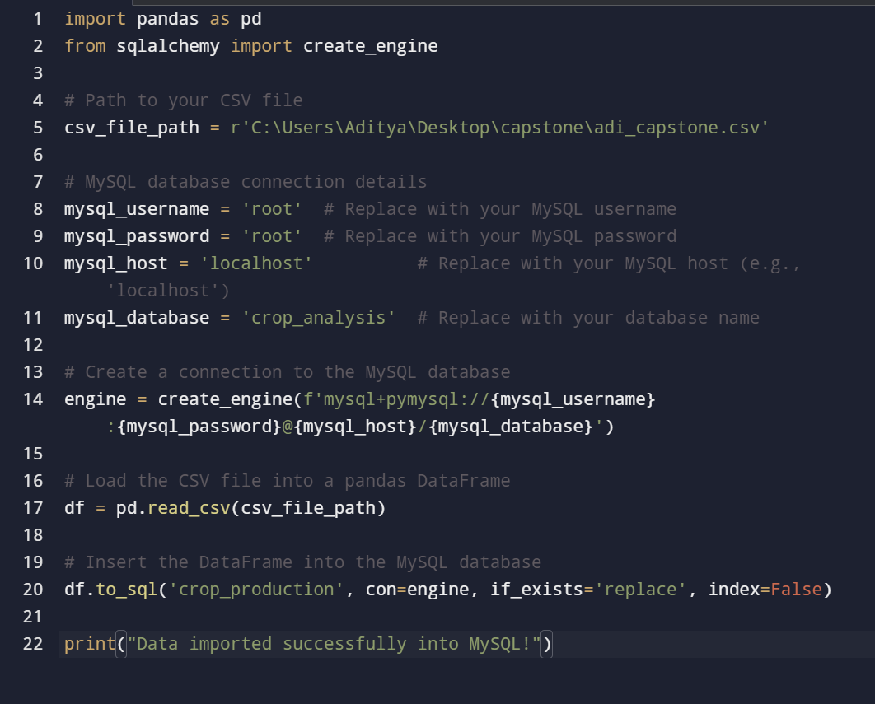
Sample Data Processing: Connecting Dataset To SQL Database.
3. Python Program For Connecting Dataset To MySQL Database
Dept of CSE, GST

Slide 31
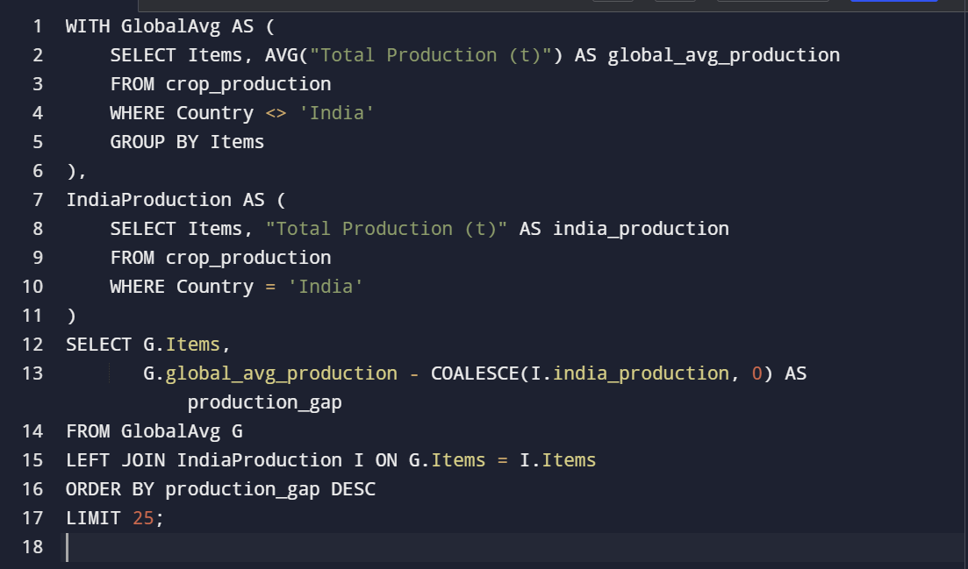
Sample Data Processing: SQL Query for finding 25 crops
4. SQL Query To Find Out The 25 High-Demand Crops In Which India is lagging.
Dept of CSE, GST

Slide 32
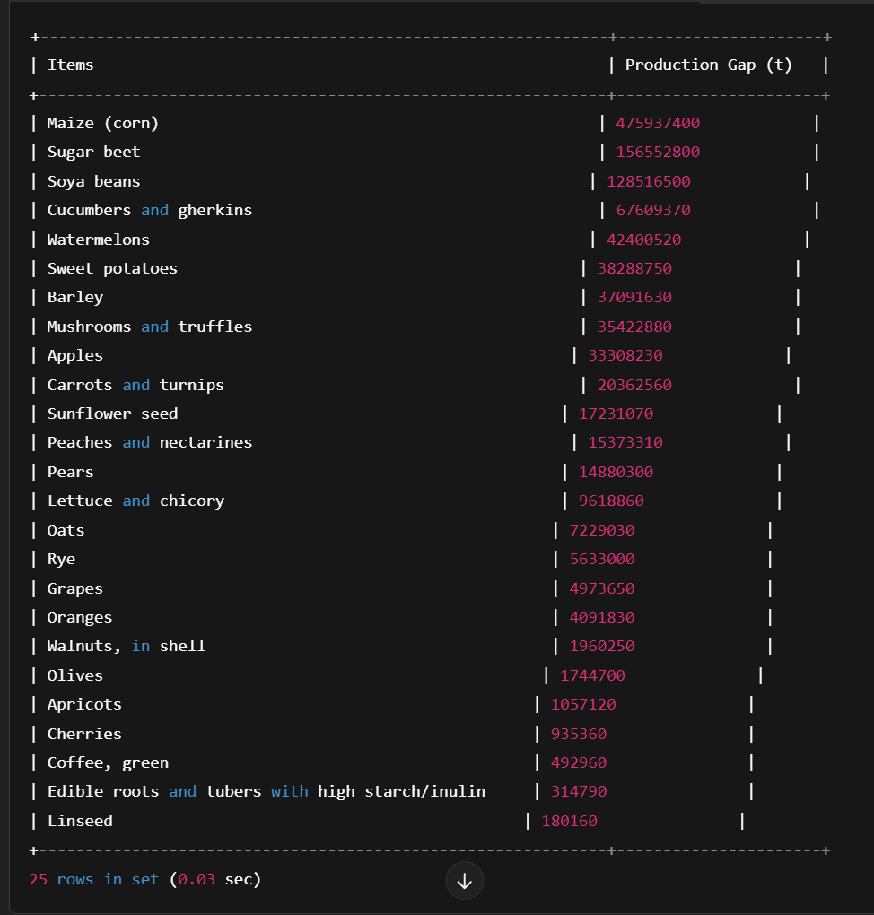
Sample Data Processing: SQL Query For Finding Top 25 High-Demand Crops
Output:
Dept of CSE, GST

Slide 33
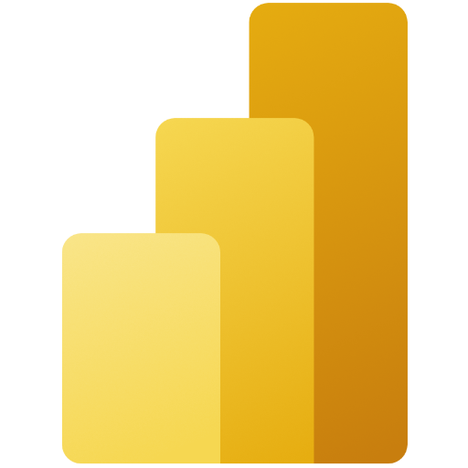
Implementation Of Dashboard
Tool Used: Microsoft Power BI
1. User-Friendly Interface
Drag-and-drop functionality makes it easy to create visualisations without coding.
Intuitive navigation for quick data exploration.
2. Powerful Data Connectivity
Connects to various data sources like Excel, SQL, cloud services, and APIs.
Supports real-time data streaming for up-to-date insights.
3. Advanced Data Visualization
Wide range of customisable charts, graphs, and maps for better insights.
Interactive dashboards with filters and drill-through options.
4. AI & Data Analytics
Built-in AI-powered insights to detect trends and anomalies.
Supports natural language queries to ask questions in plain English.
5. Seamless Integration
Works well with Microsoft tools (Excel, Azure, Teams, SharePoint, etc.).
Embeds dashboards into websites, apps, and reports.
6. Scalability & Performance
Handles large datasets efficiently using cloud-based processing.
Supports collaborative report sharing via Power BI Service.
A Few Benefits Of Using Microsoft Power BI
Dept of CSE, GST

Slide 34
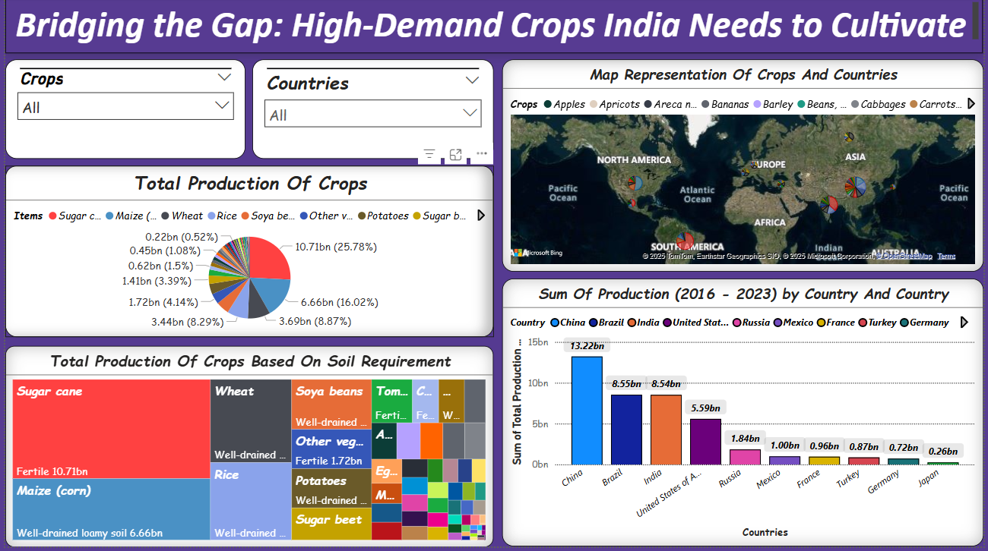
Final Dashboard
Dept of CSE, GST

Slide 35
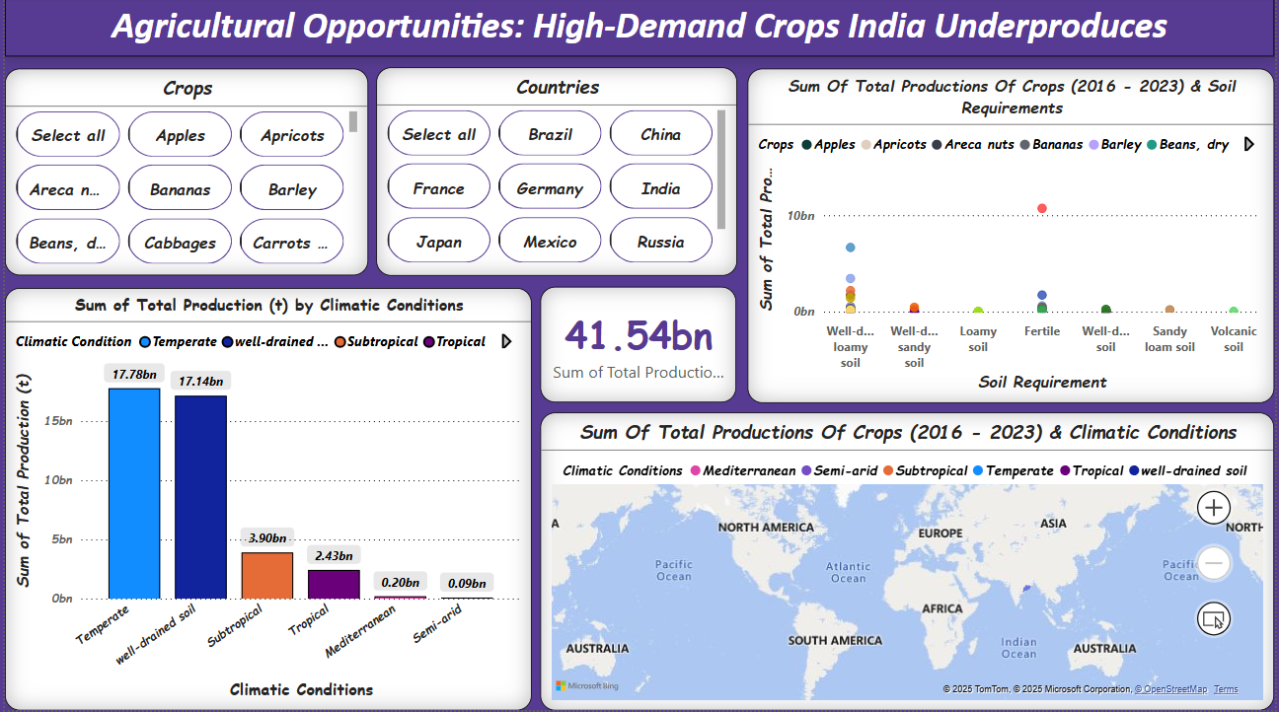
Final Dashboard
Dept of CSE, GST

Slide 36
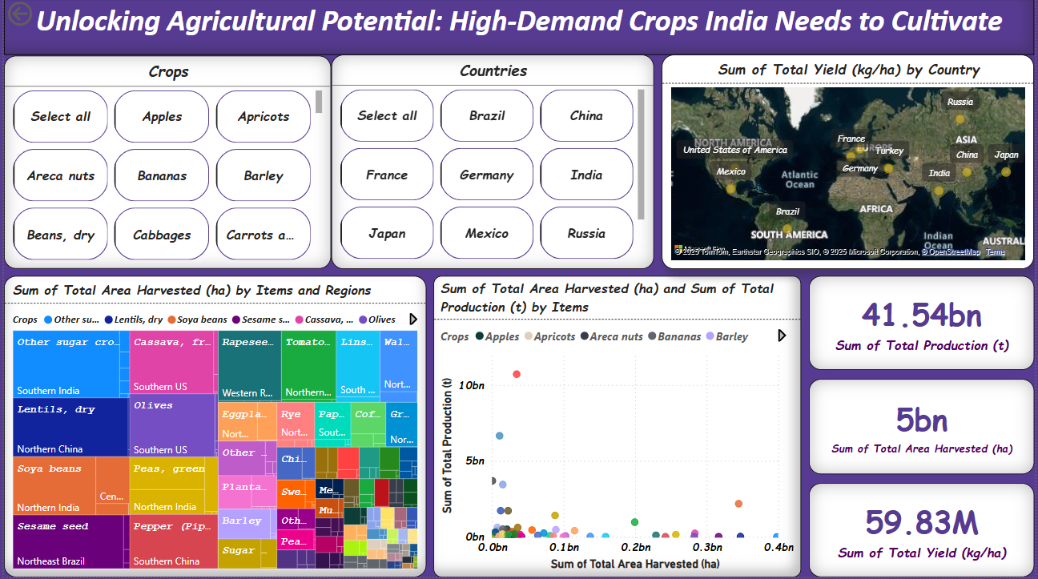
Final Dashboard
Dept of CSE, GST

Slide 37
Sample Test Cases
1. Which country has the highest total crop production from 2016 to 2023?
The bar chart titled "Sum of Production (2016 - 2023) by Country" shows total production by country. From the chart, China has the highest total crop production (13.22bn).
2. What is the total production of crops based on soil requirements?
The Treemap visualisation categorises crops based on soil requirements.
For example:
Sugarcane requires fertile soil and has a production of 10.71bn.
Maize (corn) grows in well-drained, loamy soil and has a production of 6.66bn.
3. Which climatic condition supports the highest total crop production?
The bar chart titled "Sum of Total Production (t) by Climatic Conditions" shows that Temperate (17.78bn) and Well-drained soil (17.14bn) have the highest crop production.
4. What is the total crop production across all climatic conditions from 2016 to 2023?
The central metric card indicates a total production of 41.54bn across all climatic conditions over the given period.
5. Which country has the highest total yield (kg/ha) for high-demand crops?
The world map titled "Sum of Total Yield (kg/ha) by Country" displays different countries with their respective yield levels. By analyzing the data points, we can determine which countryhas the highest yield.
6. What is the total harvested area for high-demand crops from 2016 to 2023?
The metric card on the right indicates a total harvested area of 5bn hectares, providing insight into the overall land usage for these crops.
Dept of CSE, GST

Slide 38
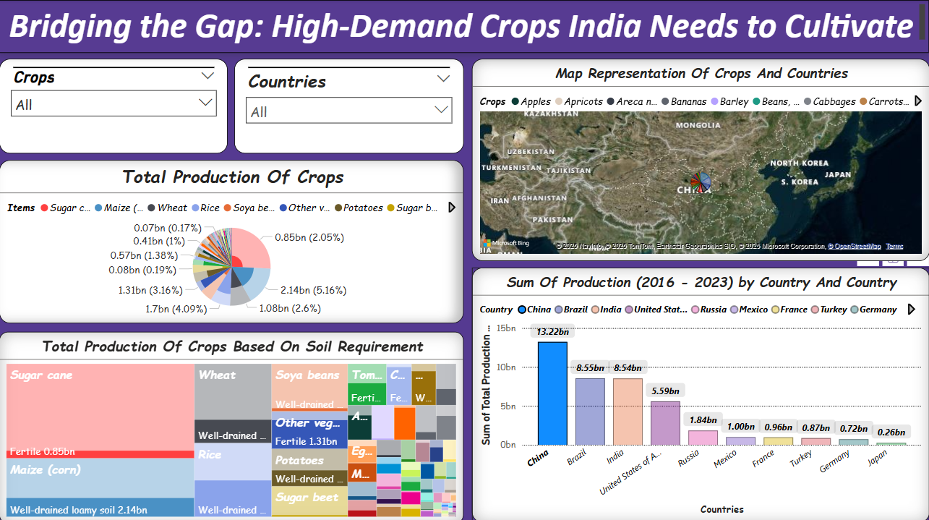
Output For The Queries
Dept of CSE, GST

Slide 39
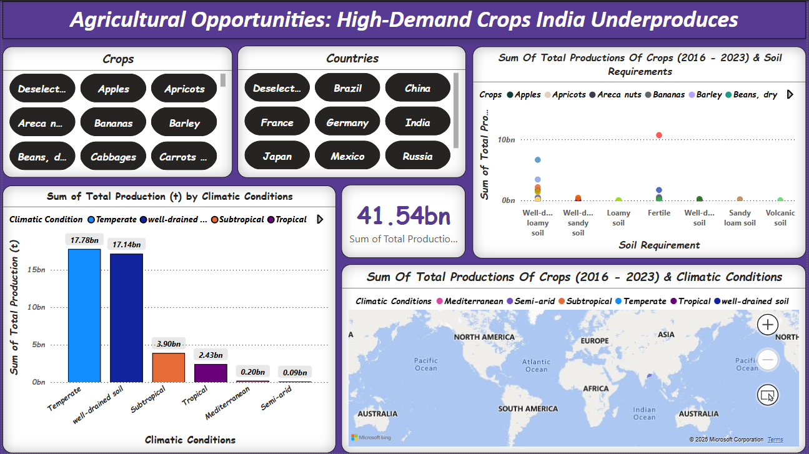
Output For The Queries
Dept of CSE, GST

Slide 40
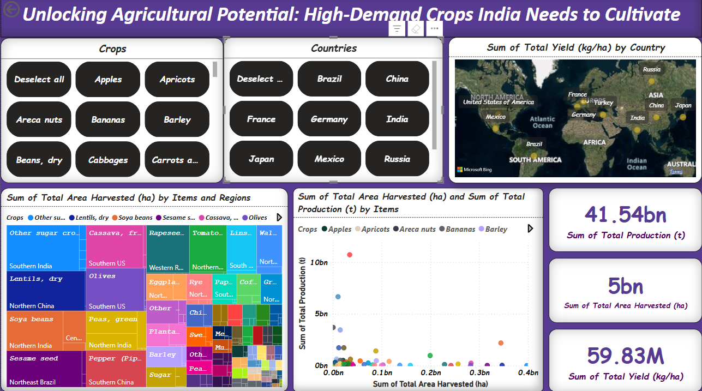
Output For The Queries
Dept of CSE, GST

Slide 41
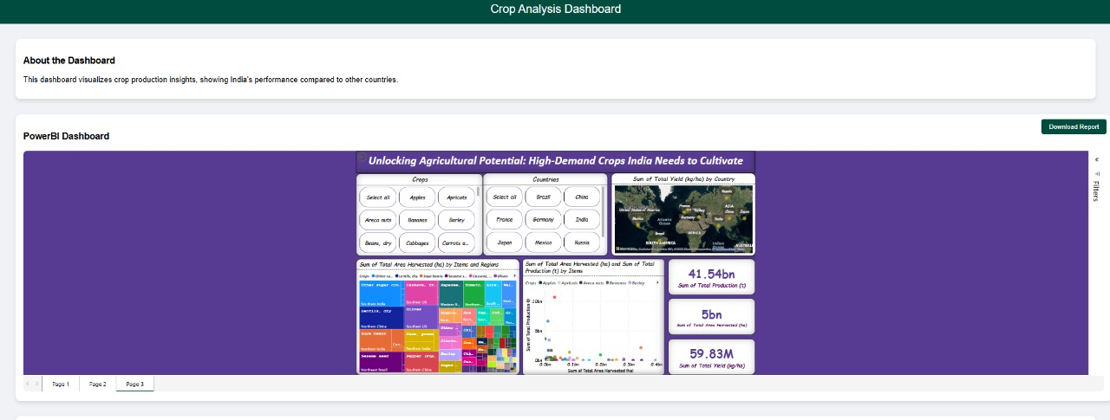
Front-End Part Of Our Project:
Designing Using Few Web Development Concepts :
HTML, CSS, Embedded URL (Token) For Connecting The Power BI Dashboard To Web Page.
Dept of CSE, GST

Slide 42
Conclusion And Future Scope:
This project successfully identified high-demand crops where India lags in production, leveraging data analysis, SQL queries, and Power BI visualisation. The insights provide a clear roadmap for improving agricultural output through targeted crop selection, optimised resource allocation, and strategic planning. The integration of Power BI ensures that stakeholders can interact with data dynamically, making informed decisions to bridge production gaps.
Future Scope
Real-Time Data Integration – Automating data pipelines for live updates in Power BI.
AI-Based Predictive Modeling – Forecasting crop demand based on climate and soil conditions.
Cloud-Based Deployment – Enhancing scalability and accessibility for stakeholders.
Advanced Filtering & Analytics – Enabling deeper insights through interactive dashboards.
These advancements will further enhance the accuracy, accessibility, and impact of the project, making it a valuable tool for agricultural policymakers, researchers, and farmers.
Dept of CSE, GST

Slide 43
Thank You
Dept of CSE, GST

